Slide 1

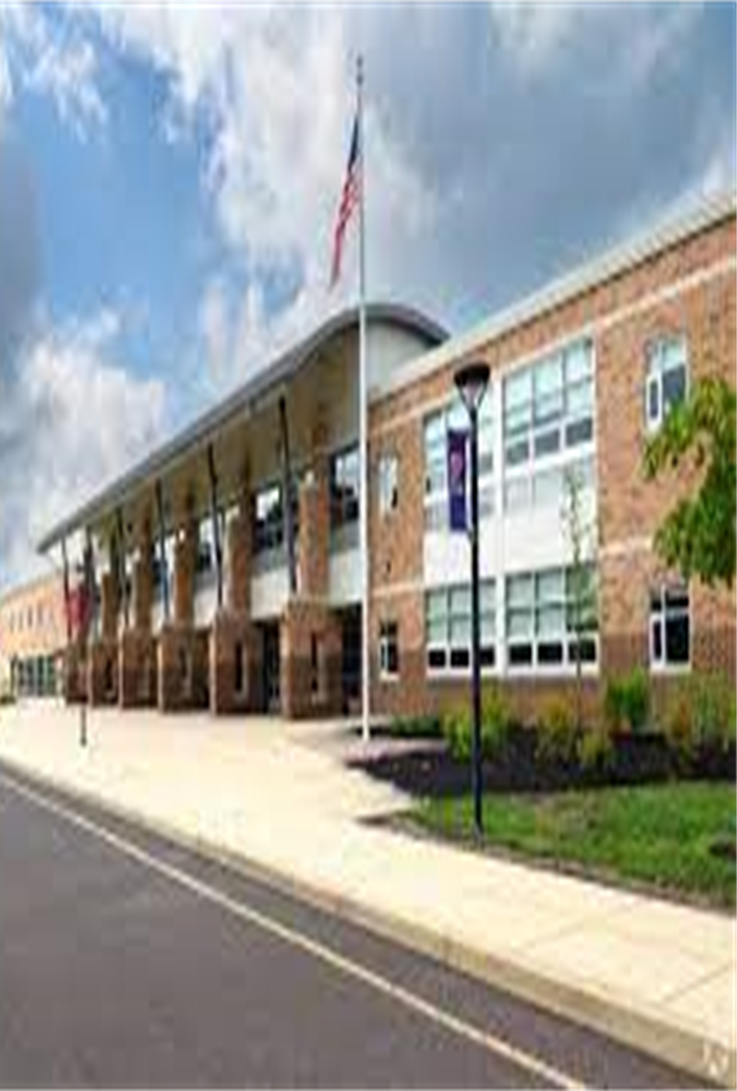

9th Grade Transition to CB EAST
Notes:
All of us welcome the students

Slide 2
Timeline for program planning
2025-2026 school year
Friday, November 15th MBIT (Middle Bucks Institute of Technology) Presentation to 9th Grade Students by Laurinda Hellwig – MBIT School Counselor
Thurs, November 21st MBIT Open House and Information Session
Thursday, January 2nd Program of Studies for Rising 10th graders available online CBSD.org
Friday, January 3rd 9th grade Program Planning Assembly during I&E –
Mrs. Louderback , Mr. Striano, Mrs. Pierangleli (Holicong) & a
counselor from CB East
Thursday, January 9th Curriculum Fair from CB East (see letter from Dr. Watters)
Beginning at 5:45 PM
Friday, January 10th Recommendation Day - Recommendations will be shared by teachers with students. ”Drag Sheet Day”
Thursday, January 16th Portal opens for students to begin input to course requests from home.
Thursday, January 18th Parent Council Presentation for 9th Grade Parents
Friday, January 31st MBIT application deadline
Sunday, February 2nd Last day for 9th grade student to enter classes into the Portal (complete by 11:59PM)
February 3rd - March 4th Holicong East Counselors will review each student schedule for completion and verification
Friday March 7th Verification sheets are available for parent review with electronic signature. Requests for changes must be submitted on Microsoft Form in link attached to Student Services email.
Wednesday March 12th Verifications in Portal due to Holicong.
No Changes can be made after this date.
Notes:
Barb

Slide 3
CURRICULUM FAIR​
Held at CB East High School on January 9th @ 5:45 ​
Meet with 10th grade teachers of all subjects, including the electives available to you next year. ​
Learn about Academic, Honors, and AP level courses.​
Review your scheduling plans with a High School Counselor.​
Ask any questions you have and check out the building!
Notes:
Barb

Slide 4
What are most 9th graders coming to 10th grade with?
1.0 Math
1.0 Social Studies
1.0 English
1.0 Science
1.0 elective in World Language or Reading
.5 PE
1.0 other elective (band, tech, art, etc.)
.25 Success Plan
6.75 TOTAL CREDITS
Student DO NOT receive credit for Resource!
Notes:
Barb

Slide 5
Central Bucks School District
High School Graduation requirements
4.0 credits of Math
4.0 credits of Social Studies (Social Studies must be taken each year, once per year)
4.0 credits of English (English must be taken each year, once per year)
3.0 credits of Science (EVERY 10th grader takes Biology)
1.0 credit of PE
.50 credits for Success Plan
10.75 electives (this includes World Language and any additional major subjects)
TOTAL CREDITS = 27.25
Notes:
Barb

Slide 6
What is left after 9th grade?
27.25 credits
-6.75 credits
20.5 credits for grades 10, 11, and 12
Students should plan to take AT LEAST 7.0 credits per year!
Colleges don’t like to see too many open spaces…they know we offer 8.0 credits!
Students have the potential to earn 31.0…3.5. this is more than required!
Notes:
Barb

Slide 7
Block scheduling in grades 10-12
The benefits to students
Organization of the School Day.
Block schedules are similar to a college course schedule: Most classes are 1 semester.
* Students can take four courses per marking period
*83 minutes each block
* Allows for “doubling up” in a subject area.
Students can take multiple Math, Science and World Language classes in one year.
Notes:
Barb

Slide 8
GENERAL INFORMATION
PE/Health is required!
Most students will take it during 10th, so you should plan for this in your schedule.
Lunch & Learn
1 hr each day
Access teachers or peer tutors for help
You can eat, hang with friends, or use the gym
A/B elective options may not fit with every class. Taking a study hall opposite of a Music/Band/Choir class is a possibility- it is okay!
Notes:
Meghan

Slide 9

BUILDING YOUR SCHEDULE
Main subject classes are entered into IC by your current 9th grade teachers based on recommendations.
Students add PE/Health, electives, and any additional classes.
Think about what you want to take during 11th and 12th so you meet course prerequisites.
Consider sports, activities, and other commitments.
You may be recommended for multiple Honors/AP classes. Remember. Balance is key!!
Notes:
Meghan

Slide 10
BUILDING YOUR SCHEDULE
AP Classes are college level courses designed by the College Board!
Reading & Writing expectations will be much higher than Honors.
For MOST students, there will be a period of adjustment.
Time & stress management are important! If you typically don’t handle time and stress well, this could be an issue with a rigorous schedule.
9th grade teacher recommendations are valuable. Your current teachers know you well and will make an informed recommendation.
Notes:
Meghan

Slide 11
Sample Standard Schedule
1 Block=.5 credit
2 Blocks=1.0 credit
 | 1st Marking Period | 2nd Marking Period | 3rd Marking Period | 4th Marking Period
Block 1 | English 10 | English 10 | Spanish 3 | Spanish 3
Block 2 | Modern World History | Modern World History | Journalism | PE/Health
Block 3 | Biology | Biology | Geometry | Geometry
Block 4 | Intro to Law | Astronomy | Accounting 1 | Accounting 1
Notes:
Meghan

Slide 12
Sample AP Schedule
1 Block=.5 credit
2 Blocks=1.0 credit
 | 1st Marking Period | 2nd Marking Period | 3rd Marking Period | 4th Marking Period
Block 1 | English 10 | English 10 | Spanish 3 | Spanish 3
Block 2 | AP European History | AP European History | AP European History | PE/Health
Block 3 | Biology | Biology | Geometry | Geometry
Block 4 | Intro to Law | Astronomy | Accounting 1 | Accounting 1
Notes:
Meghan

Slide 13
Sample MBIT Schedule
1 Block=.5 credit
2 Blocks=1.0 credit
 | 1st Marking Period | 2nd Marking Period | 3rd Marking Period | 4th Marking Period
Block 1 | English 10 | English 10 | Biology | Biology
Block 2 | Modern World History | Modern World History | Geometry | Geometry
Block 3 | MBIT | MBIT | MBIT | MBIT
Block 4 | MBIT | MBIT | MBIT | MBIT
Notes:
Meghan

Slide 14
Sample music Schedule
1 Block=.5 credit
2 Blocks=1.0 credit
 | 1st Marking Period | 2nd Marking Period | 3rd Marking Period | 4th Marking Period
Block 1 | English 10 | English 10 | Spanish 3 | Spanish 3
Block 2 | Modern World History | Modern World History | Journalism | Intro to Law
Block 3 | Biology | Biology | Geometry | Geometry
Block 4 | Choir (A) ____________ PE/ Health (B) | Choir (A) ___________ PE/Health (B) | Choir (A) ___________ Digital Imaging (B) | Choir (A) __________ Digital Imaging (B)
Notes:
Meghan

Slide 15
Dual enrollment
Students enrolled in dual enrollment courses will receive Central Bucks credit on their high school transcript and the corresponding college course credits on the Delaware Valley University transcript. 1
1. Sociology (no preq)
2. Environmental Sustainability (no preq)
Course are taken at CB Est during the school day and taught by CB East faculty. The decision to potentially earn college credit will be made during the first week of each semester.Students taking these Delaware Valley University dual enrollment courses will pay $100 per credit, which will be billed directly by the university. Final cost will be $300. (Cal 1 will be $400)
Course Availability: The scheduling process is not changing, and no class is guaranteed. Course placement depends on fulfilling graduation requirements, scheduling parameters, and teacher availability. Therefore, requesting and applyniig for dual enrollment courses does not guarantee enrollment.
Notes:
Greg

Slide 16
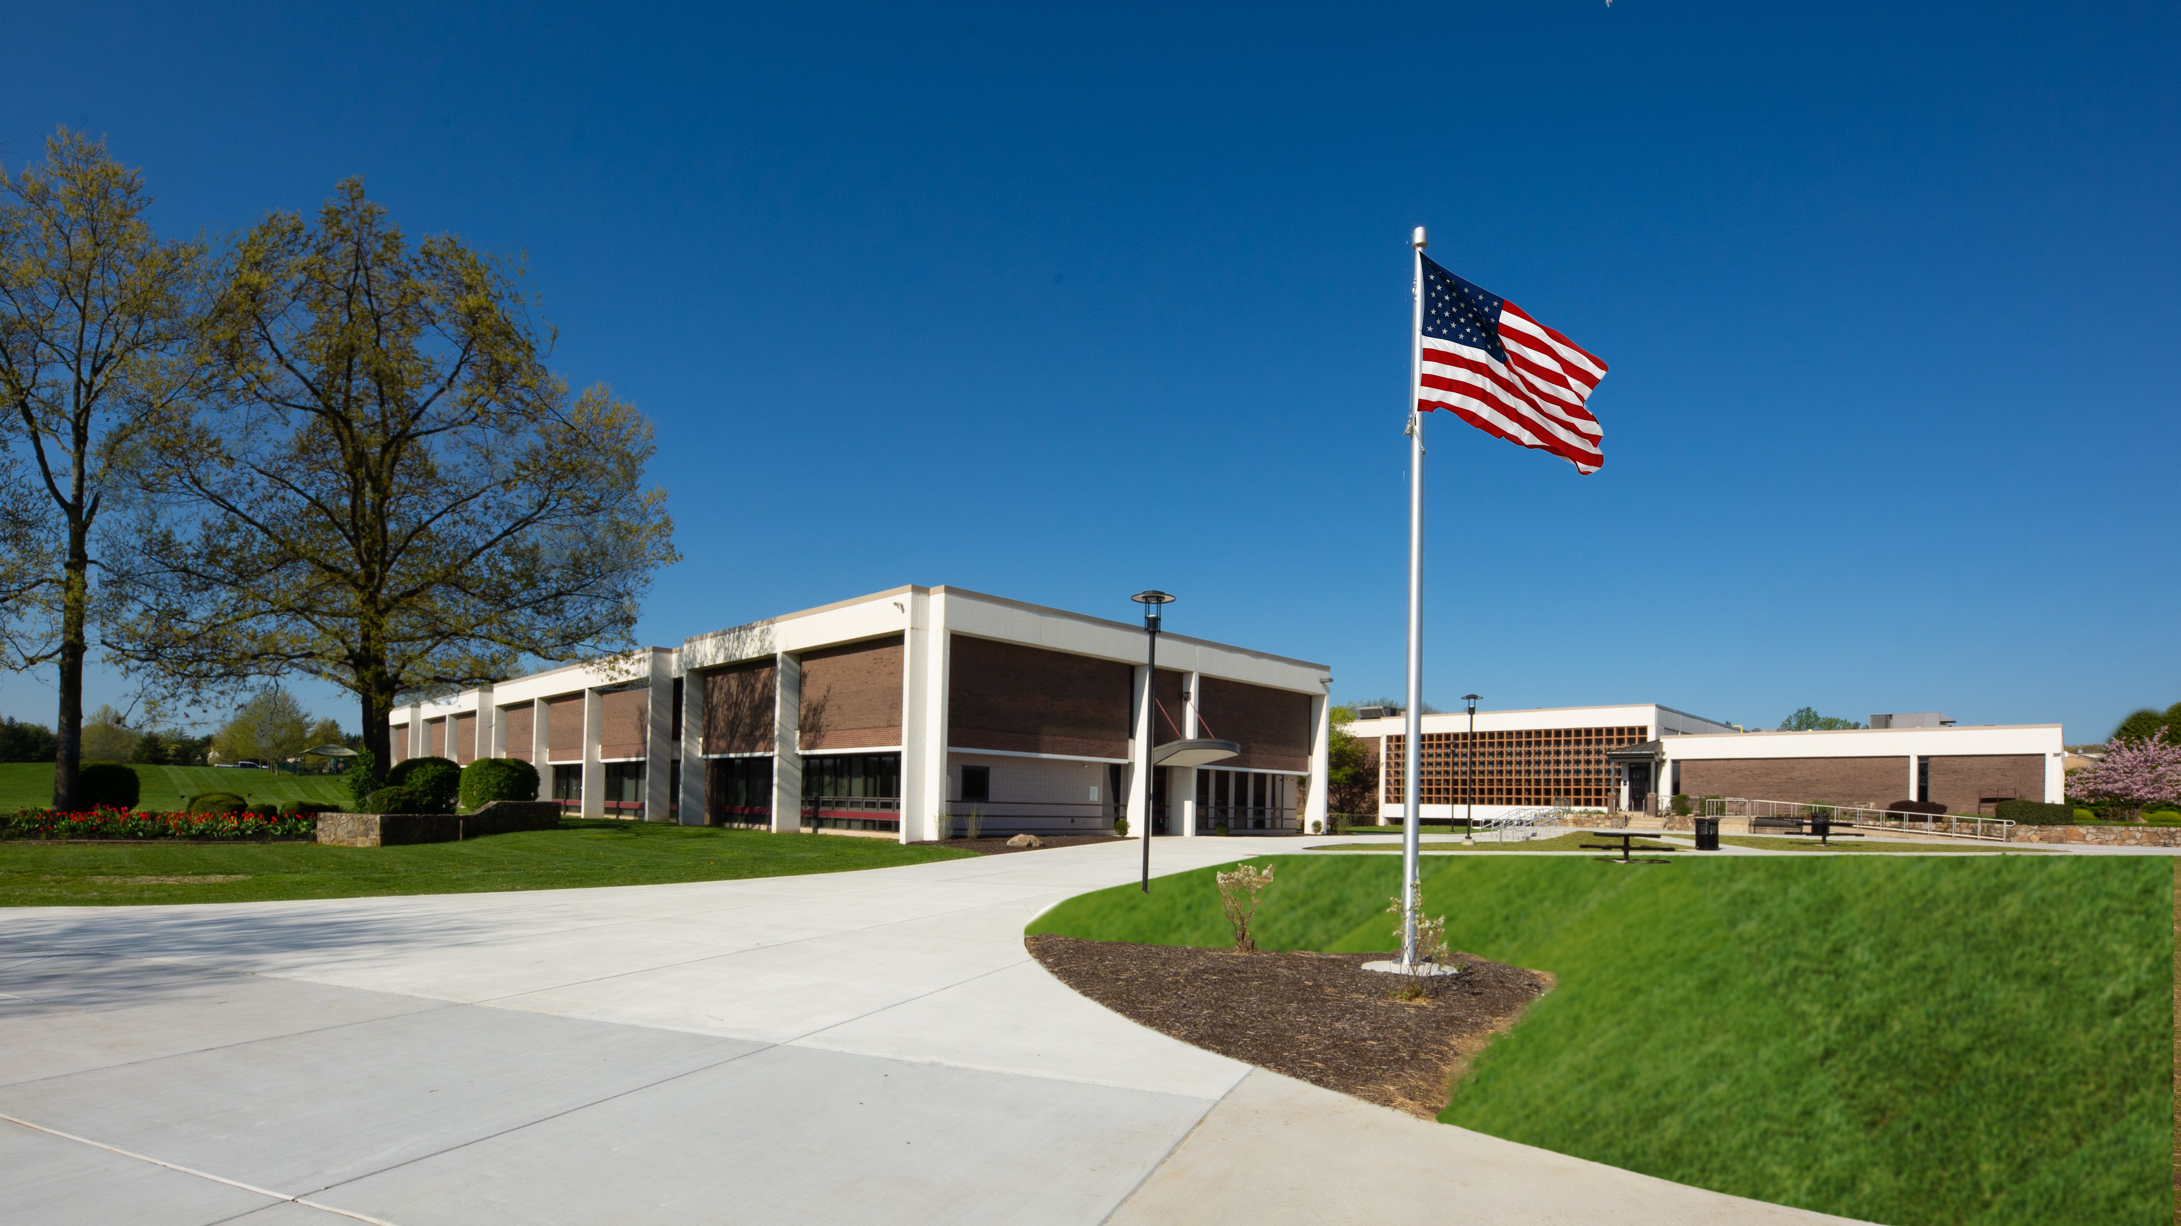

Middle Bucks
Institute of Technology (MBIT)
Many programs are available in both Skilled Trades and Collegebound Pathways. Learn more at MBIT.org.
Offers Career opportunities immediately after graduation!
Elective credits earned at MBIT, and core subject area credits at East.
You can schedule a tour of the building and see programs of interest.
Apply online by January 31(ASAP)-Limited space for some programs!
Notes:
Greg

Slide 17

SELECTING COURSES
Drag Sheet on Friday, January 10th ​
Speak with your teachers about courses / levels.​
Current 9th teachers enter recommendations they will ​
begin speaking with you this week.​
Courses will be listed in student IC Portal / Verification Sheet. ​
Enter Electives into IC Portal​
Open from Thursday, January 16th to Sunday, February 2nd ​
You will receive detailed instructions on how to enter in course requests.​
Choose electives carefully, you cannot change them after Program Planning!​
School Counselors Meetings​
MS & HS counselors will meet with each freshman to review your schedule. ​
​
Notes:
Greg

Slide 18
GPA Weighting
Grade | Academic | Honors | Advanced Placement
A | 4.0 | 4.25 | 5.0
A- | 3.6 | 3.85 | 4.6
B+ | 3.4 | 3.65 | 4.4
B | 3.0 | 3.25 | 4.0
B- | 2.6 | 2.85 | 3.6
C+ | 2.4 | 2.65 | 3.4
C | 2.0 | 2.25 | 3.0
C- | 1.6 | 1.85 | 2.6
D+ | 1.4 | 1.65 | 2.4
D | 1.0 | 1.25 | 2.0
Notes:
Greg

Slide 19

High school critical course change policy
Once you register for a course, and the window for changes has closed, (March 12th) changes may ONLY be made for the following reasons:
A deficiency in a prerequisite.
Misplacement into a course.
Must repeat a course due to the failure of a required course.
Notes:
Greg

Slide 20
Counselors Program Planning Resources
Holicong Middle School Holicong website>Student Services>
Meghan Pierangeli – 9th grade Canvas>Class of 2028>
Barbara Louderback - Learning Support Program Meet your Counselor
Gregory Striano - Autistic Support Program,
Emotional Support Program, and 504s
267-893-2710
CB East 2024-2025 assignments
Ms. Russo A-cro mrusso@cbsd.org
Mr. Sandstrom Crp-harg wsandstrom@cbsd.org
Ms. Bryant-Gray harh-l tbryantgray@cbsd.org
Mrs. Barone-Durant m-puh tdurant@cbsd.org
Mr. Moustakas pur-sma gmoustak@cbsd.org
Mrs. jones smb-z mejones@cbsd.org
Notes:
Greg

